Slide 1
Programming II
(C Programming Language)
C Scope Rules and C Storage Classes
Lecture 10, Wednesday February 24, 2021
Dr. Ayman ALJARBOUH

Slide 2
Outline
C Scope Rules
C Storage Classes

Slide 3
C Scope Rules
A scope is a region of the program where a defined variable can have its existence, and beyond that region the variable cannot be accessed
There are three places where variables can be declared in C programming language:
    Inside a function or a block, variables are called local variables
    Outside of all functions, variables are called global variables
    In the definition of function parameters, variables are called formal parameters

Slide 4
Local Variables
Variables that are declared inside a function or block are called local variables
They can be used only by statements that are inside that function or block of code
Local variables are not known to functions outside their own

Slide 5
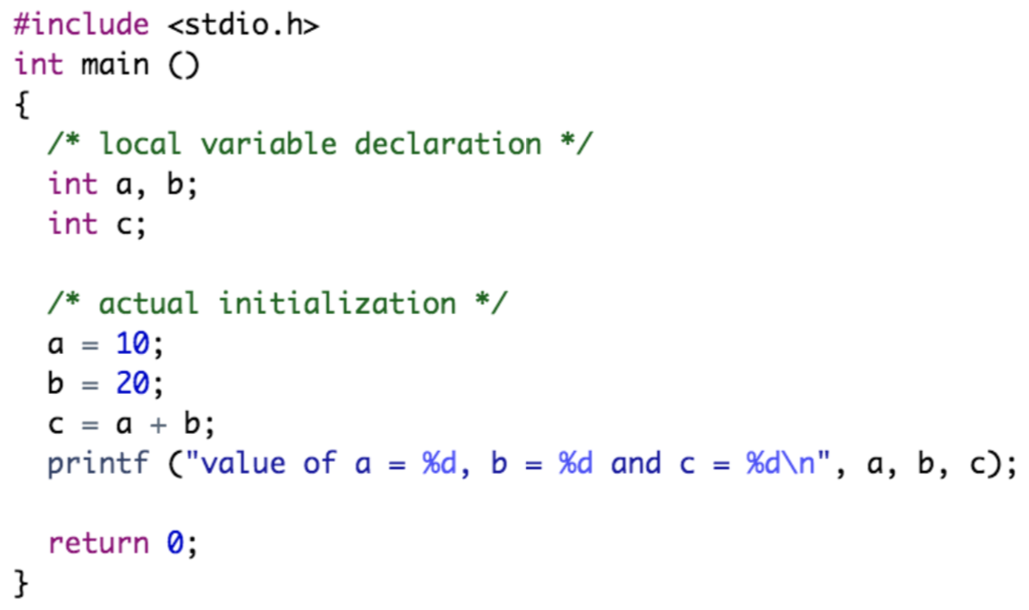
Local Variables
Example:
Here all the variables a, b and c are local to main() function

Slide 6
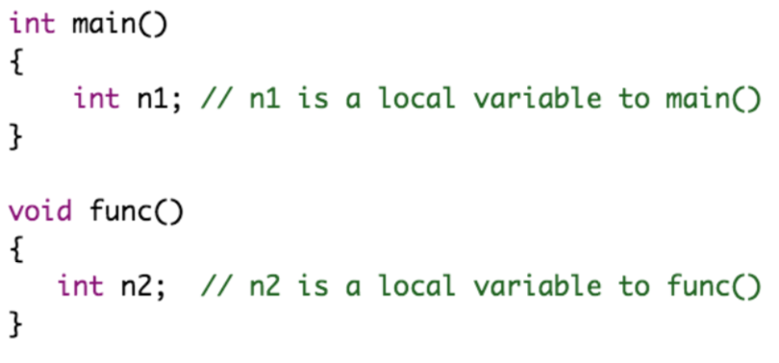
Local Variables
Example:
Here n1 is local to main() and n2 is local to func(). This means you cannot access the n1 variable inside func() as it only exists inside main(). Similarly, you cannot access the n2 variable inside main() as it only exists inside func()

Slide 7
Global Variables
Variables that are declared outside of all functions are called global variables
Global variables will hold their value throughout the lifetime of your program
Global variables can be accessed inside any of the functions defined for the program
A program can have same name for local and global variables but value of local variable inside a function will take preference

Slide 8
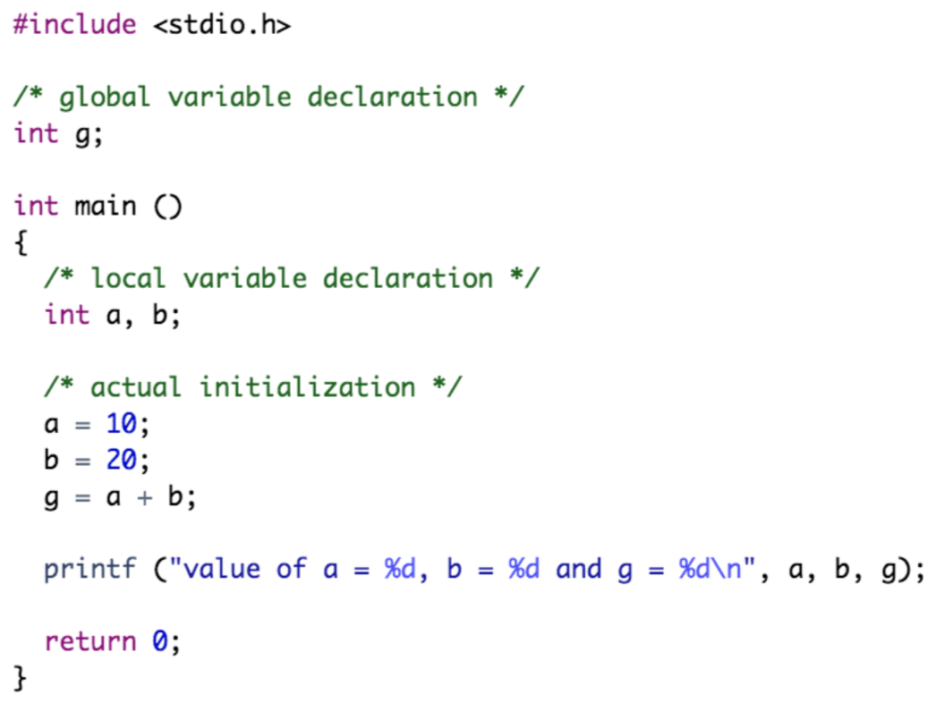
Global Variables
Example:

Slide 9
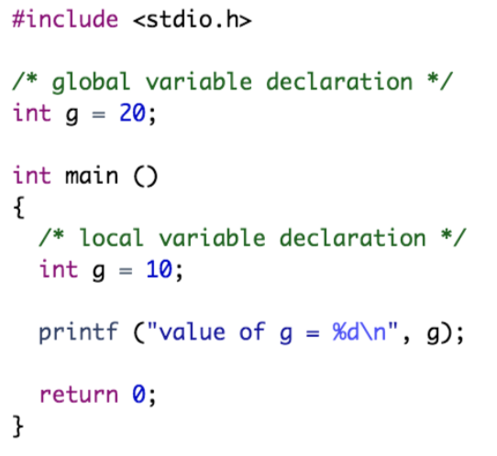
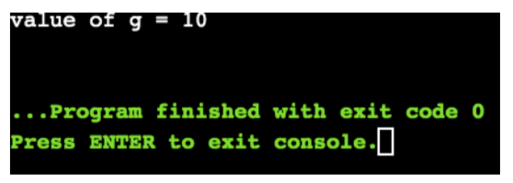
Global Variables
Example:
The same name g is used for local and global variables but value of the local variable g inside the function will take preference

Slide 10
Formal Parameters
Function parameters are called formal parameters
Formal parameters are treated as local variables within that function
Formal parameters take preference over the global variables

Slide 11
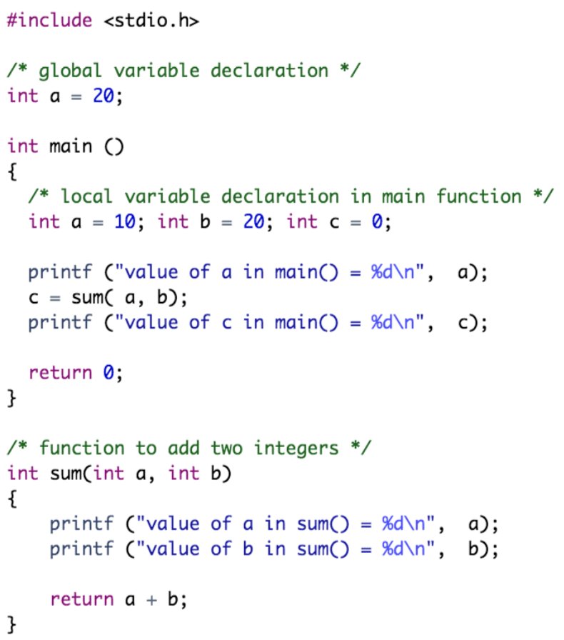
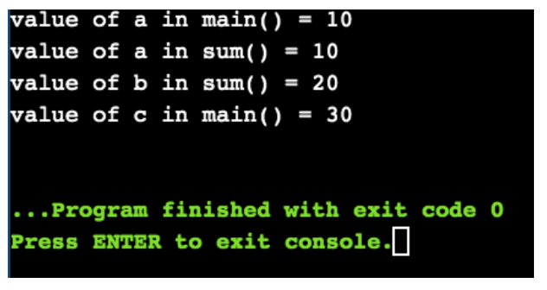
Formal Parameters
Example:

Slide 12
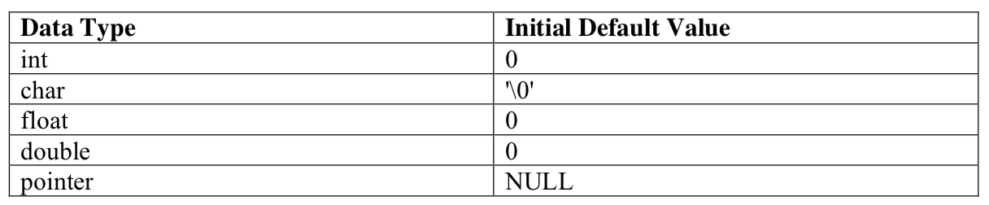
Initializing Local and Global Variables
When a local variable is defined, it is not initialized by the system, you must initialize it yourself
Global variables are initialized automatically by the system as follows:
It is a good programming practice to initialize variables properly otherwise, your program may produce unexpected results because uninitialized variables will take some garbage value already available at its memory location

Slide 13
Outline
C Scope Rules
C Storage Classes

Slide 14
C Storage Classes
A storage class defines the scope (visibility) and life-time of variables and/or functions within a C Program
The storage class specifiers precede the type that they modify
There are two types of storage classes in C:
  The Static Storage Class
  The Extern Storage Class

Slide 15
Static Storage Class
The static storage class instructs the compiler to keep a local variable in existence during the life-time of the program instead of creating and destroying it each time it comes into and goes out of scope
Static variables preserve the value of their last use in their scope
Static variables are initialized only once and exist till the termination of the program. Thus, no new memory is allocated
Global static variables can be accessed anywhere in the program. By default, they are assigned the value 0 by the compiler

Slide 16
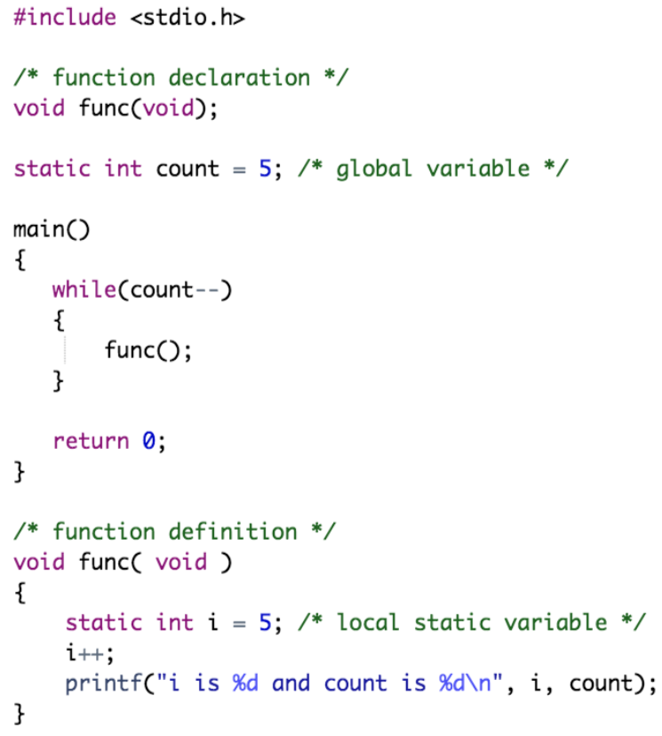
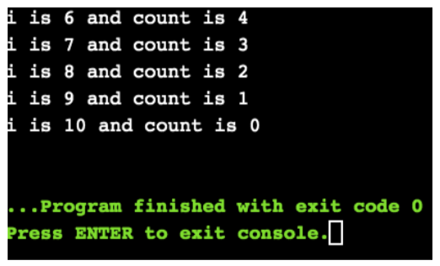
Static Storage Class
Example:

Slide 17
Extern Storage Class
The extern storage class is used to give a reference of a global variable that is visible to ALL the program files. When you use ‘extern’
When you have multiple files and you define a global variable or function, which will be used in other files also, then extern will be used in another file to give reference of defined variable or function
Just for understanding, extern is used to declare a global variable or function in another file
The extern modifier is most commonly used when there are two or more files sharing the same global variables or functions

Slide 18
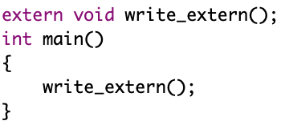
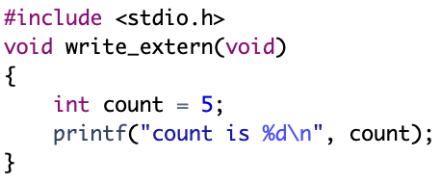
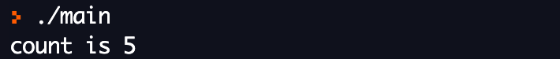
Extern Storage Class
Example:
First File: main.c
Second File: write.c
Compile the two files: $gcc main.c write.c
This will produce an executable file, when this file is executed, it produces the following result: count is 5

Slide 19
Practical Exercises
Write and Compile the following C programs:
Program 1:

Slide 20
Practical Exercises
Write and Compile the following C programs:
Program 2:

Slide 21
Practical Exercises
Write and Compile the following C programs:
Program 3:

Slide 22
Practical Exercises
Write and Compile the following C programs:
Program 4:

Slide 23
Practical Exercises
Write and Compile the following C programs:
Program 5:

